Slide 1
Establishment of long-term cultures of newt cardiomyocytes: an in vitro model for heart regeneration
Bo Sun
Wayzata High School
March 19, 2011

Slide 2
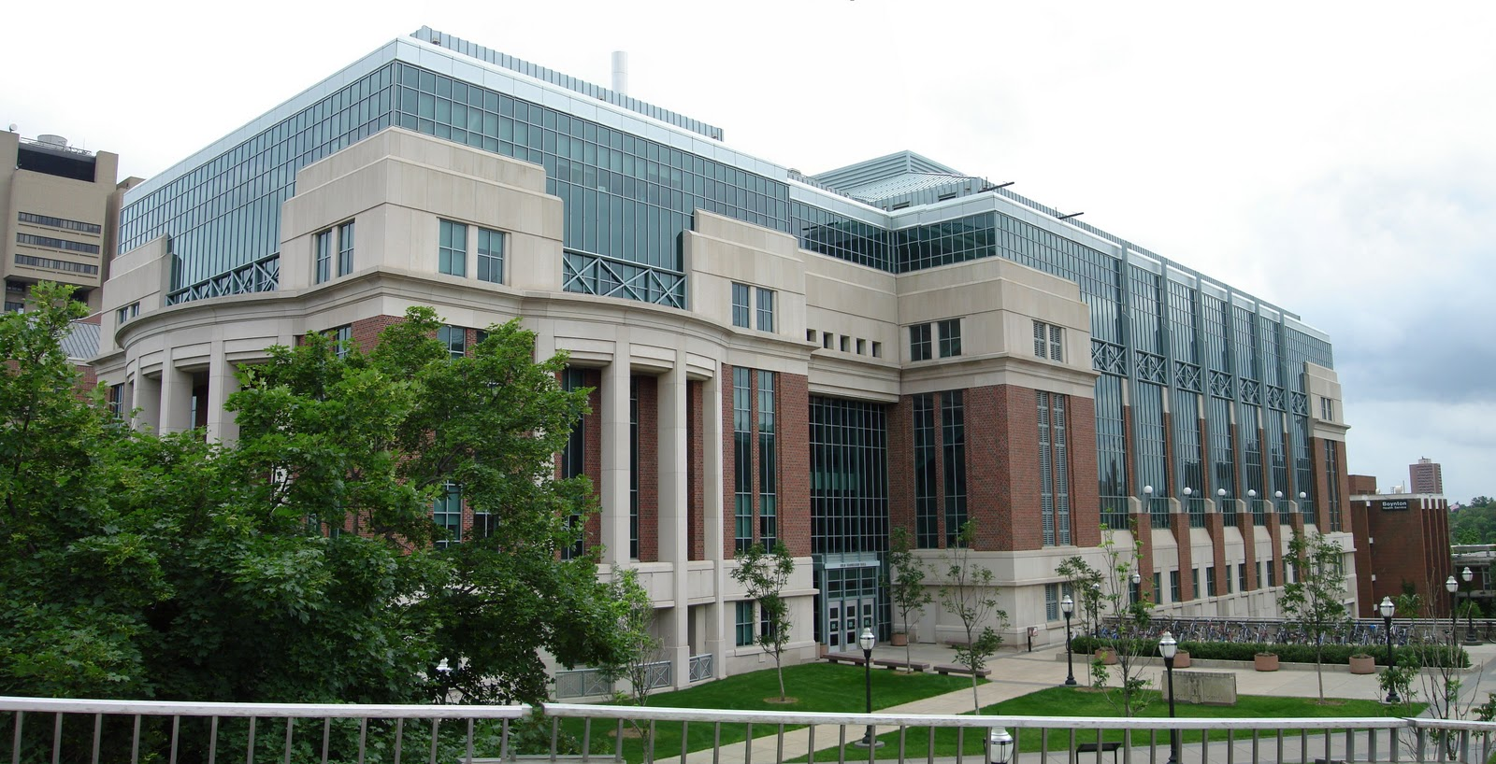
Acknowledgements
Dr. Daniel J. Garry
Kathy Bowlin
Dr. Bhairab Singh
Princesa VanBuren Hansen
Lillehei Heart Institute, University of Minnesota

Slide 3
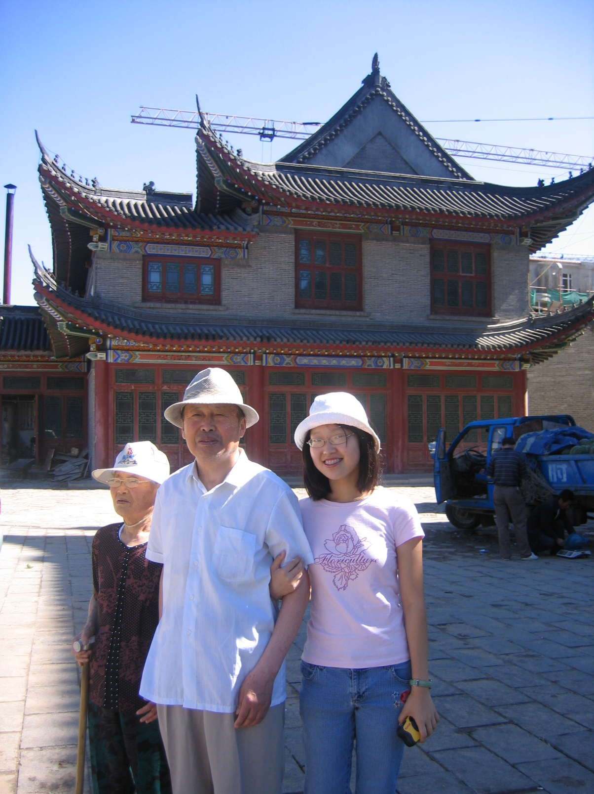

Slide 4
Introduction
Heart disease is the leading cause of death in the United States
Mammals:
Substantial injury to myocardium
Limited capacity for regeneration
Loss of contractile tissue, fibrosis, scar formation
Teleost Fish and Amphibians:
Dedifferentiation and
proliferation of cardiomyocytes
Regenerate and restore functionality
Substantial injury to the myocardium

Slide 5
Eastern Red-spotted Newt (Notophthalmus viridescens)

Slide 6
Purpose
Determine the best method to isolate live cardiomyocytes from whole newt ventricles
Establish the culture conditions for the long-term culture of newt cardiomyocytes
Identify characteristics of long-term cell cultures with respect to cell morphology, proliferative capacity, and cell type-specific markers

Slide 7
Hypothesis
A successful newt cardiomyocyte cell line as a model for heart regeneration will be established.
Using the suggested methodologies, this research will:
1. Successfully isolate newt cardiomyocytes from whole ventricles;
2. Fully define the culture conditions to culture newt cardiomyocytes long-term; and
3. Successfully identify characteristics of the long-term culture.

Slide 8
Specific Aim 1: Determine the best method to isolate live cardiomyocytes from whole newt ventricles
Goal: maximize number and quality of cells obtained
3 pilot studies
Constants:
Number of newt ventricles
Substrates for attachment
Culture incubation conditions
Enzyme solution
Variables:
Initial digestion time
Length of cycles
Total length of enzymatic dissociation

Slide 9
Pilot Study #1
5 days after plating
17 days after plating

Slide 10
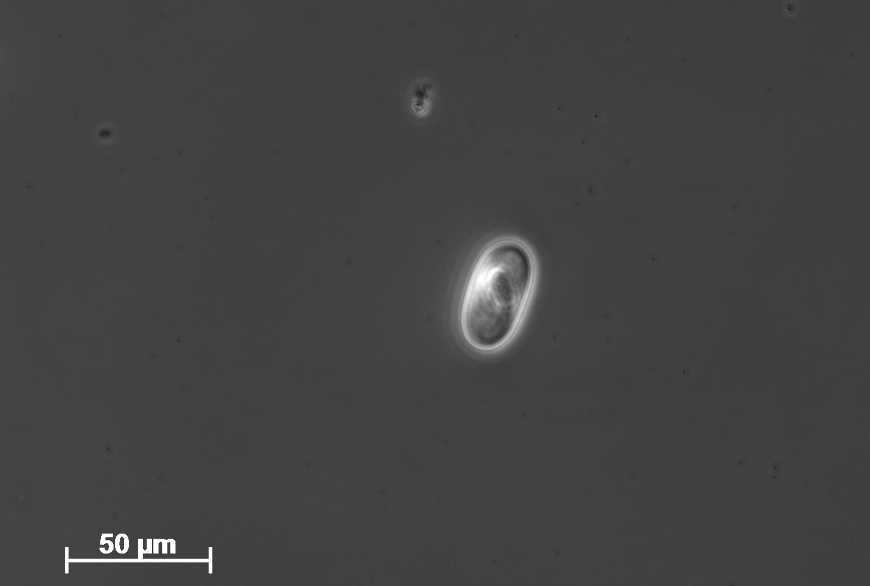
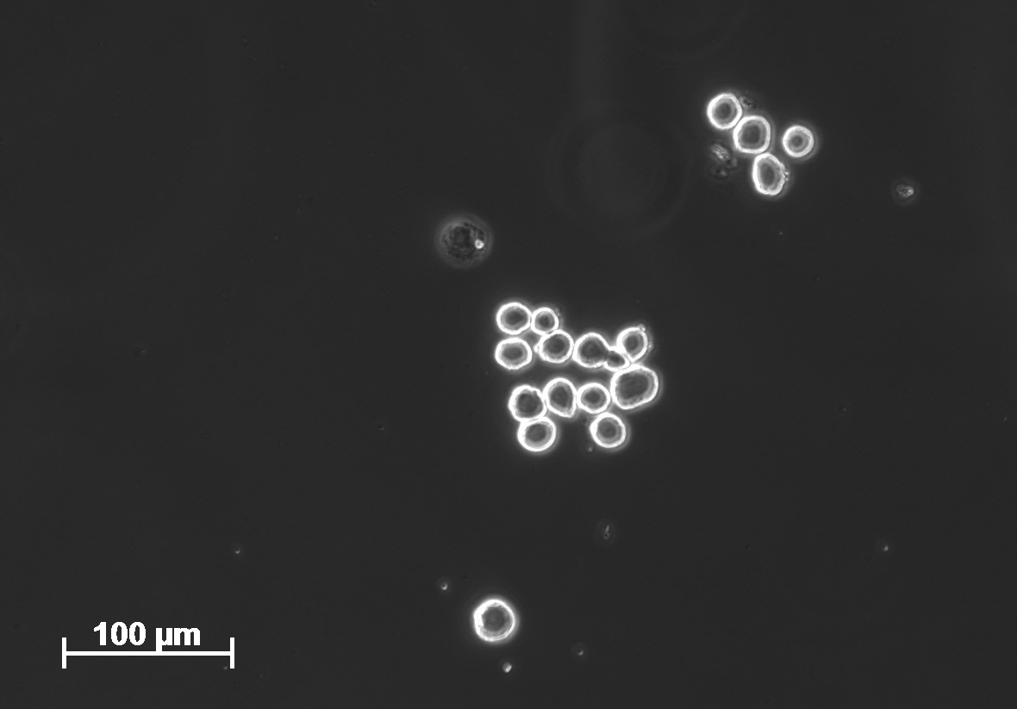
Pilot Study #2
Hematoxylin & eosin staining
24 hours after isolation

Slide 11
Pilot Study #3
8 hours
139 days in culture
7 passages

Slide 12
Specific Aim 2: Establish the culture conditions for the long-term culture of newt cardiomyocytes
Tested 4 substrates: TC treated plastic, glass, poly-D-Lysine, Mouse laminin
Frequency of medium change
Best confluency

Slide 13
Specific Aim 3: Identify characteristics of the long-term cell cultures with respect to cell morphology, proliferative capacity, and cell type-specific markers

Slide 14
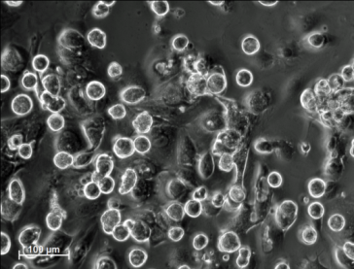
Primary Cultures of Newt Cardiomyocytes and Morphology

Slide 15
6 days after plating

Slide 16
Cells in Cultures Proliferate

Slide 17
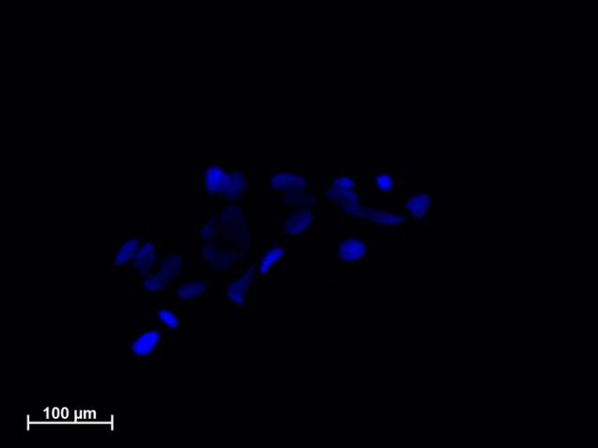
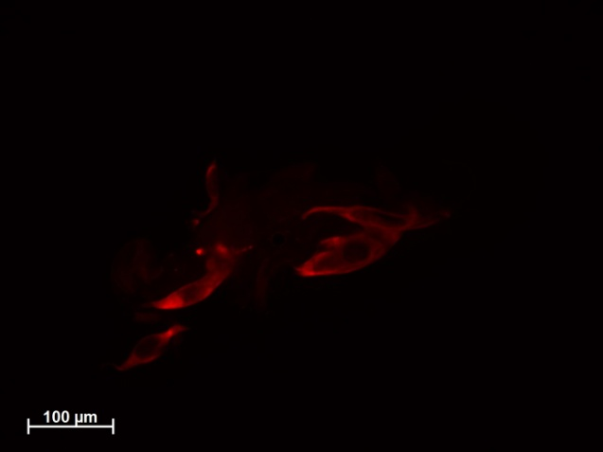
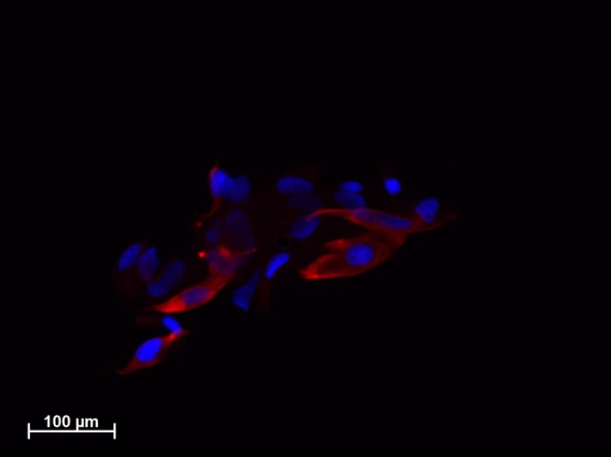
Cells in Culture Exhibit Cardiac Markers
11 days after plating
PI
MyHC
Merged
48 days after plating
DAPI
MyHC
Merged
112 days after plating
DAPI
MyHC
Merged

Slide 18
Limitations
Possibility of singular occurrence
No previous basis for length of cell survival
Repeated isolations will confirm enzymatic isolation protocol & culture conditions
Additional immunohistochemical analysis

Slide 19
Conclusions
Three pilot studies established the best method to isolate live cardiomyocytes from whole newt ventricles
The necessary culture conditions to culture the isolated newt cardiomyocytes long-term were established
Long-term cultures were characterized by cell morphology, active proliferative capacity, and the positive immunohistochemical staining of cardiac-specific markers

Slide 20
Significance
Progressing toward a continuous cell line
First but significant step
139 days in culture
Research is unique
Making the connection to humans
Common mechanisms
Mouse model
Regeneration of human hearts
End goal: Long life, increased quality of life

Slide 21
Future Research
Single cell cloning by limiting dilution
Signaling pathways
Wnt
Notch
Enhance the proliferative capacity of cardiomyocytes in vitro

Slide 22
