Slide 1
2010 Minnesota Water Plan: Working together to ensure clean water and healthy ecosystems for future generations
April 4, 2011
Princesa VanBuren Hansen
Environmental Quality Board

Slide 2
Overview
EQB & background
State water plan
Example applications
Next steps

Slide 3
Environmental Quality Board
Administration
Agriculture
Commerce
Employment & Economic Development
Health
Natural Resources
Pollution Control
Transportation
Water & Soil Resources
5 citizen members
9 Commissioners
Governor’s representative

Slide 4
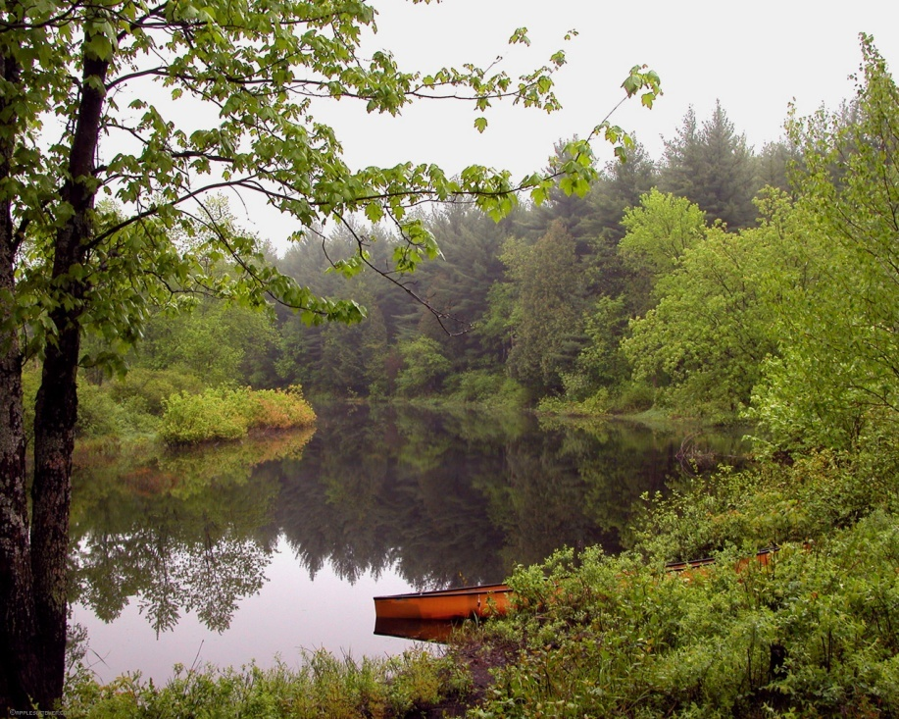
EQB Mission
The Board’s mission is to …
Investigate environmental issues that cut across agency interests
Coordinate state plans and policy
Ensure compliance with
state environmental policy
Engage Minnesotans

Slide 5
Recent Water Sustainability Efforts
2007 – Use of Minnesota’s Renewable Water Resources: Moving Toward Sustainability
2008 – Managing for Water Sustainability: A Report of the EQB Water Availability Project

Slide 6
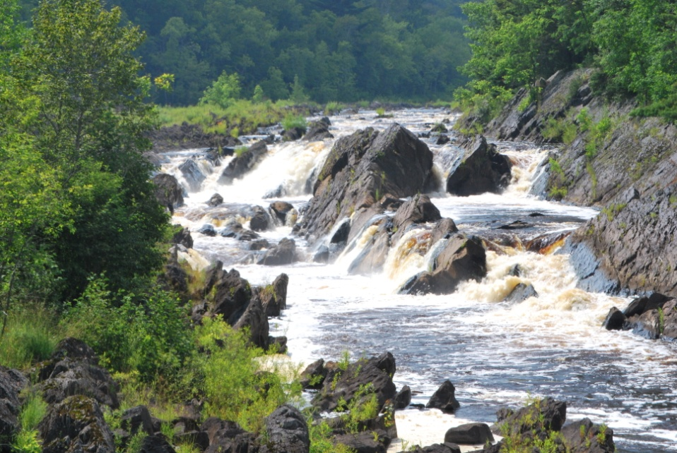
EQB Water Plan Statute & History
EQB charge
Rich history
Working together
Responsible to future generations

Slide 7
Goals of the Report
Define a vision for the future
Build a broad, adaptive framework
Articulate state strategies to achieve sustainable water management
Inform the U of M process, while ensuring coordination and efficiency

Slide 8
Report Outline
Part 1 - Reflecting on the Past
State water plans of 1979, 1991 and 2000
Transformational milestones
Part 2 - Evaluating the Status of Minnesota’s Water Resources in the Present
Water monitoring, quality assessment and trends, and metropolitan planning efforts
Part 3 - Charting a Roadmap for the Future

Slide 9
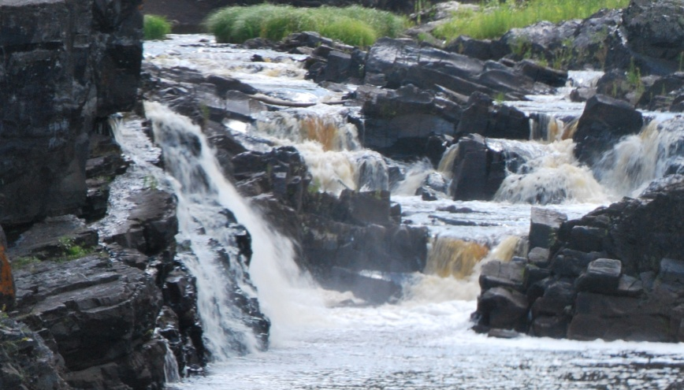
Charting a Roadmap for the Future
Strategies
Communicate what needs to be done
Advance the foundation built in recent years
Implementation principles
Overarching principles
Define how to implement the strategies
Water sustainability is the goal

Slide 10
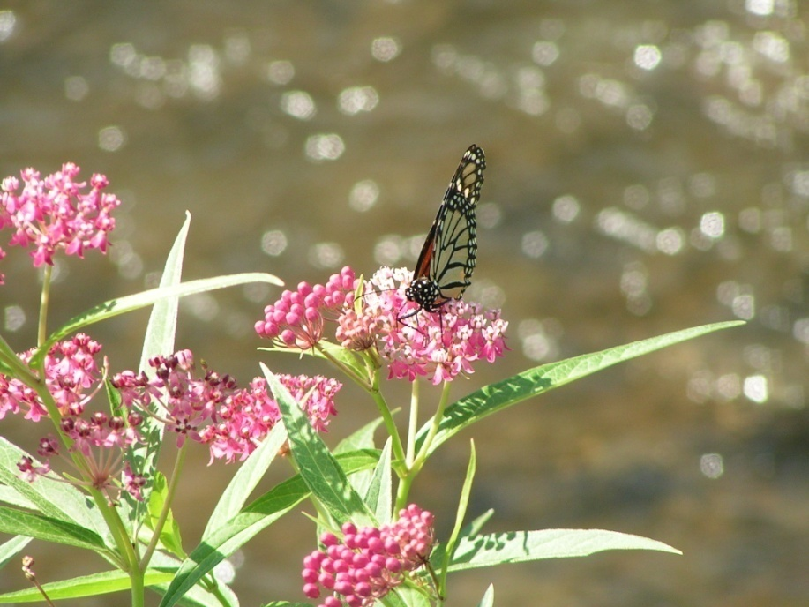
Strategies
Increase protection efforts
Promote wise and efficient use of water
Restore and enhance local capacity
Employ water resource management units

Slide 11
Strategies
Collect essential information
Improve access to data
Provide implementation tools
Target approaches for protection & restoration
Apply a systematic approach for emerging threats

Slide 12
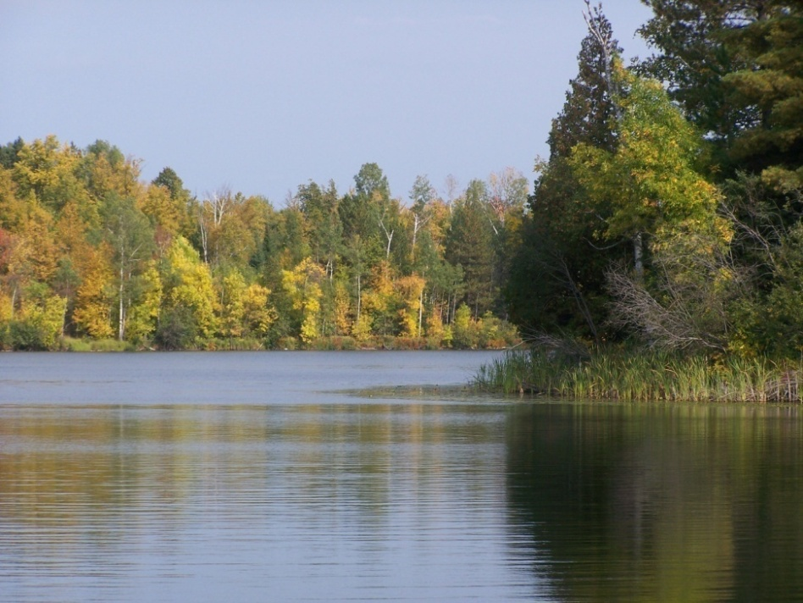
Implementation Principles
Optimized coordination
Prioritized resources
Comprehensive land and water management
Adaptive management
Goals and measures
Education and outreach
Shared, long-term vision

Slide 13
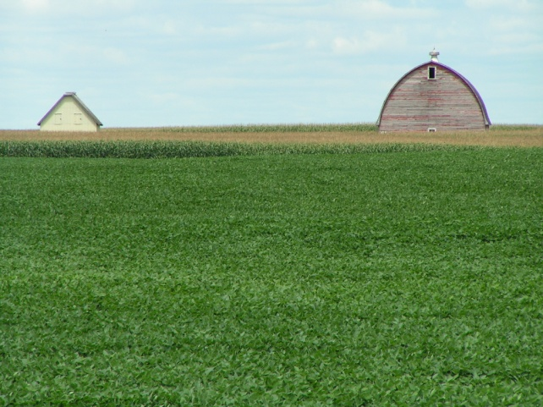
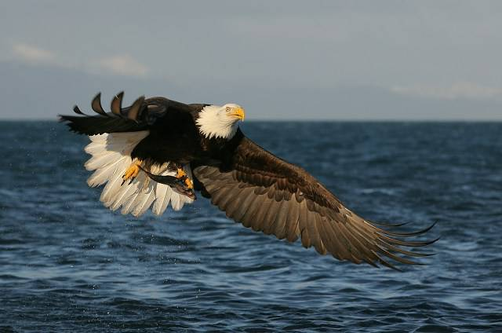
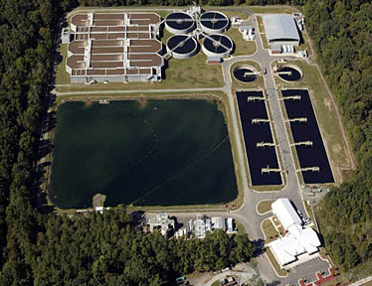
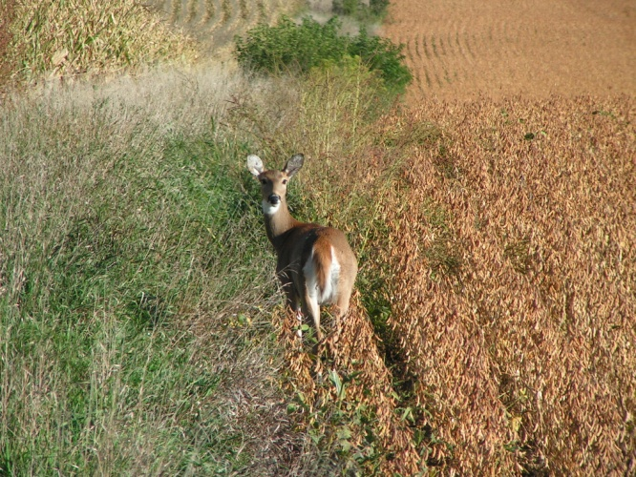
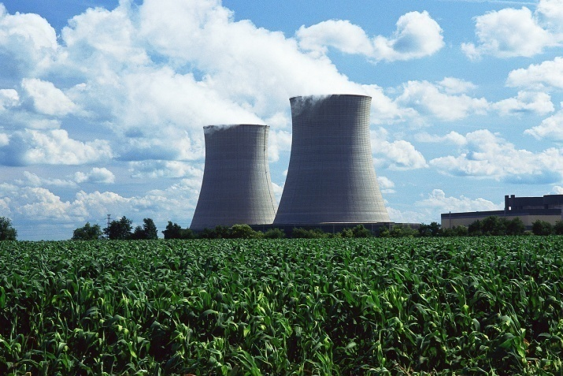
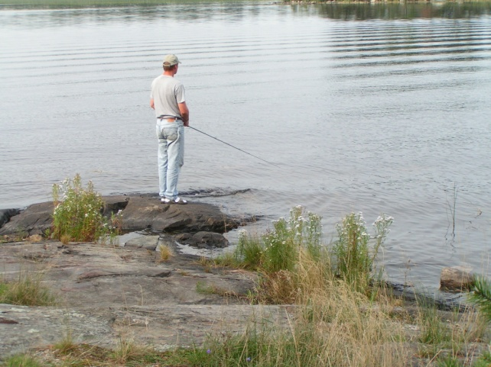
Recognition of the Sustainable System
Social
Economic
Environmental

Slide 14
Example Applications
Groundwater management areas
Contaminants of emerging concern
Impaired waters

Slide 15
Groundwater Management Areas
Employ water resource management units
Optimize coordination
Restore & enhance local capacity
Adaptive management

Slide 16
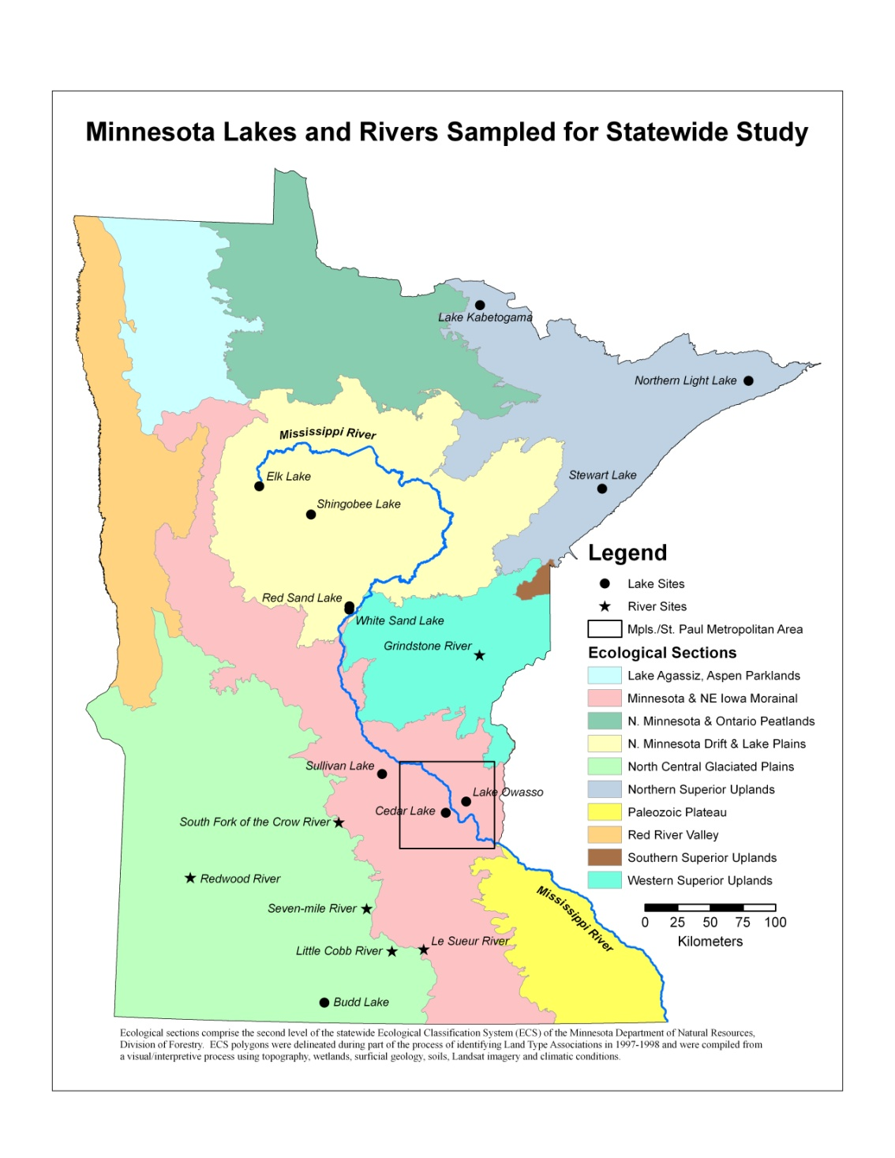
Contaminants of Emerging Concern
Collect essential info for water management decisions
Improve access to environmental data
Apply a systematic approach for emerging threats

Slide 17
Impaired Waters
Comprehensive land & water management
Provide current implementation tools
Employ a targeted approach for protection & restoration

Slide 18
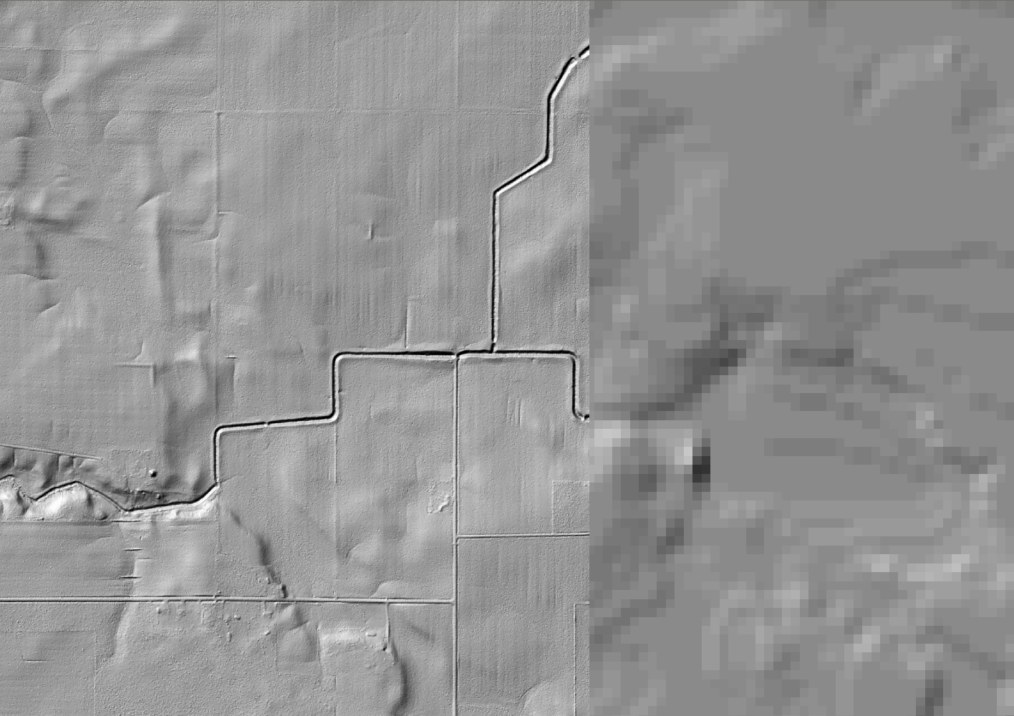
Tools for Targeting & Implementation
LiDAR 3 m DEM
USGS 30 m DEM
Notes:
Same area as shown in the previous slide from a different view with the 30 m data to the right of the orange line and the 3 m data to the left.

Slide 19
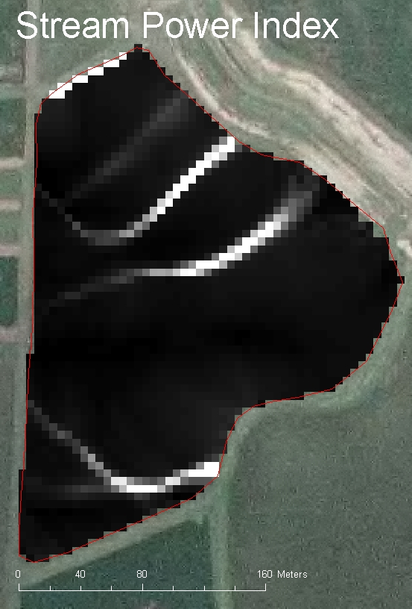
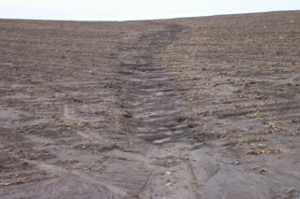
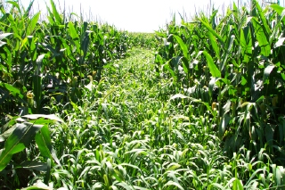
Notes:
Example of applying terrain analysis using high resolution topographic data to identify critical areas. In this case the terrain attribute identified the potential for ephemeral gully formation in this 13 ac field. This approach is solely based on topography and ignores other factors that may effect surface runoff such as residue management, climate, etc. However, with relatively minimal input, a user can define potential areas within a watershed that are vulnerable to surface runoff.

Slide 20
Precision Conservation
Notes:
These critical areas were identified using terrain analysis based on LiDAR data. These critical areas depicted as ‘pointsheds’ where field confirmed places in the watershed that had the potential for a hydrologic connection between the riparian area and the ditch (i.e. surface runoff and its associated analytes could potentially be transported to the ditch during a precipitation event). These areas represent <30% of the overall watershed area.

Slide 21
Adaptive Management Applied
Abundance – management
GW & SW separation – single resource
Quantity & quality independence – managed together
Point specific decision-making – integrated, system view
Stream reach – watershed assessment
Quality, quantity, ecosystems, humans, society, economy and quality of life

Slide 22
Strengths of the Plan
Unifies state water activities
Articulates consensus & commitment
Promotes a dynamic, adaptive approach to water management

Slide 23
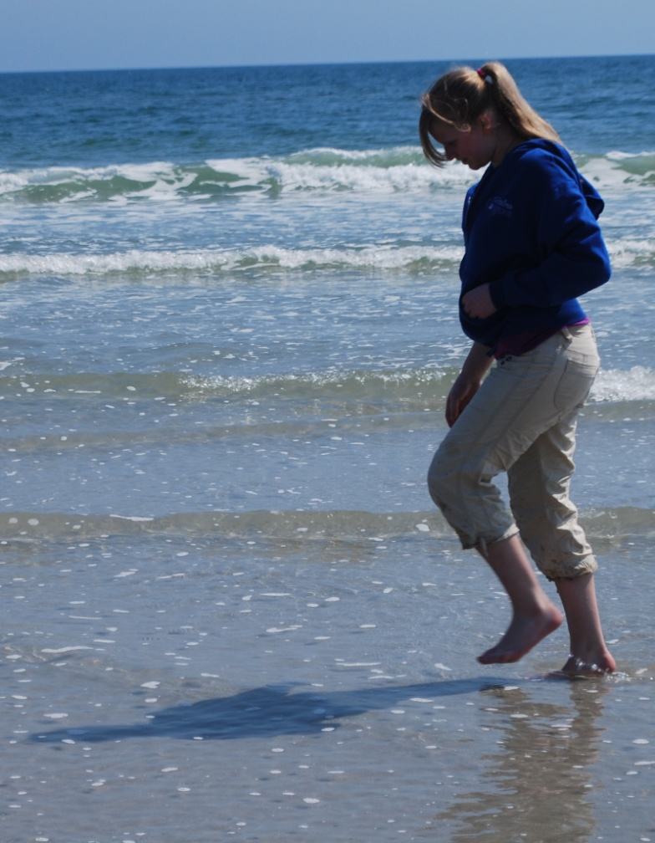
Next Steps
Apply the plan to state activities
Implement CWF priorities
Review U of M Framework
Measure progress and adapt

Slide 24
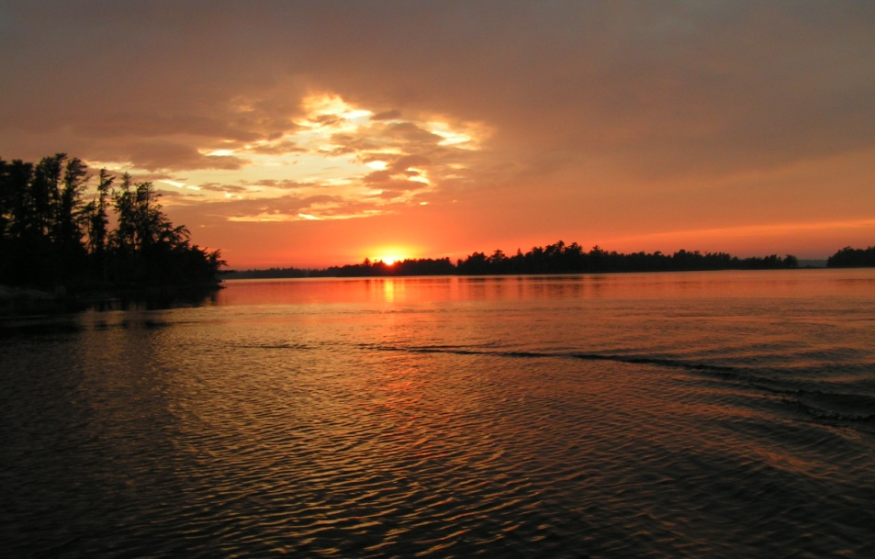
Thank You
Project contact:
Princesa VanBuren Hansen
princesa.vanburen@state.mn.us
651-201-2478

