Slide 1
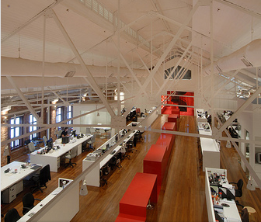
THE OFFICE
RELOCATION
PROJECT
OFFICES ? WORKSTATIONS ?
'CAFE' FACILITIES ? TECHNOLOGY STATIONS e.g.printers,copiers, ?
MEETING ROOMS, INFORMAL RELAXATION SPACES ? CREATIVE ENHANCEMENTS e.g. aquariums, galleries ? RECEPTION AREAS ?

Slide 2
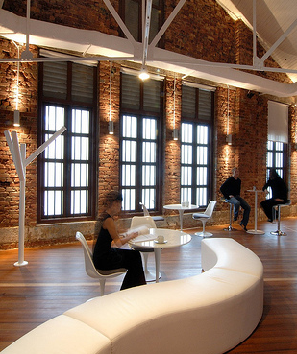
Benefits of Efficient Layout
1. Provides effective allocation and use of floor space.
2. Creates a pleasant working environment.
3. Has a positive impact on clients.
4. Facilitates efficient work flow.
5. Provides efficient, productive work areas.
6. Facilitates future expansion.
7. Facilitates employee supervision.

Slide 3
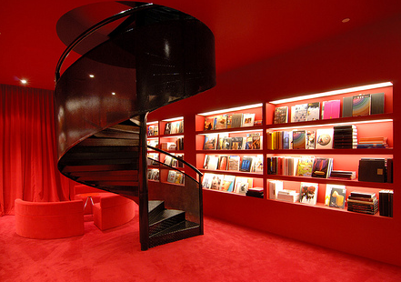
Flexible Work Practices Impacting
Office Layout and Design
Telecommuting
Work-Based Teams
Hoteling

Slide 4
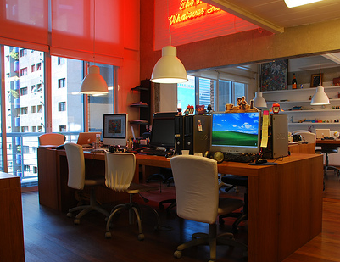
A work arrangement that
allows employees to perform
some or all of their work
off the premises.
Telecommuting
Layout Impact
Employees will not need
a full-fledged office on
the premises.

Slide 5
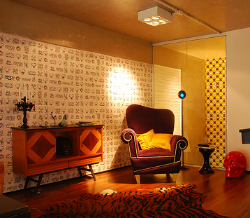
A work arrangement in which
employees do much of their
work in a team environment.
Work-Based Teams
Layout
Impact
Requires an open
environment that facilitates
ready communication
and a greater number of small conference areas.

Slide 6
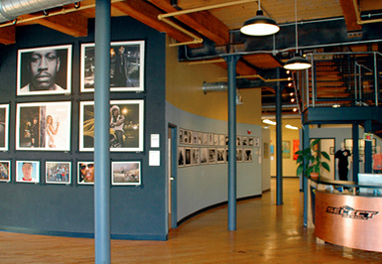
Hoteling
A work arrangement that
involves employees who spend
a significant amount of their
time off premises.
Layout
Impact
These employees
can often
function
using a work carrel
when on the premises.

Slide 7
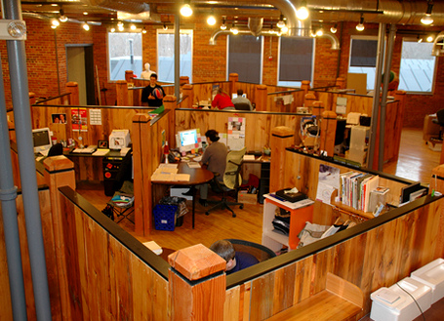
Factors to Consider in Undertaking Preliminary
Planning for Layout
Tasks
The work employees perform has
a significant role in determining
the type of office facilities they
need.
Work flow
The flow of work through an
office affects the placement of
employees and the equipment they
use to carry out their work.

Slide 8
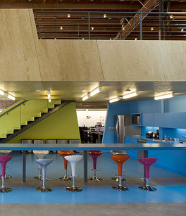
Factors to Consider in Undertaking Preliminary
Planning for Layout
Organization Chart
It is used to assess the lines of
authority in the organization as
well as to identify the job relationships among employees.
Projection of Employees
Needed in the Future
This helps determine the type and
amount of additional office
space that will be needed in the
future because of growth.

Slide 9
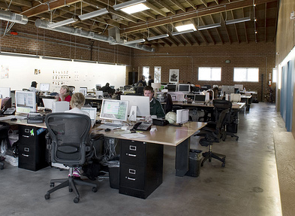
Factors to Consider in Undertaking Preliminary
Planning for Layout
Communication Network
The nature of telephone,
e-mail, and face-to-face
contact between individuals.
Departmental Organisation
The location of departments
in relation to each other and
within the organization
affects organizational
efficiency.

Slide 10
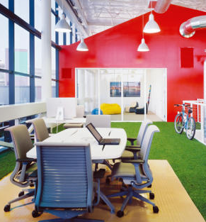
Factors to Consider in Undertaking Preliminary
Planning for Layout
Private and General Offices
Installing more private offices
and fewer general offices
presents greater challenges
for designing layout.
Space Requirements
The space requirements of
individuals and/or departments
help determine the total amount
of office space to provide.

Slide 11
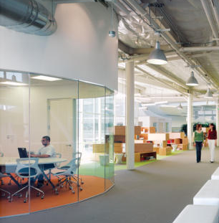
Factors to Consider in Undertaking Preliminary
Planning for Layout
Specialized Areas
A variety of specialized areas
within the organization have
their own layout requirements.
Safety Requirements
The layout needs to facilitate
the efficient movement of
employees from one area
to another.

Slide 12
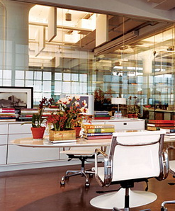
Factors to Consider in Undertaking Preliminary
Planning for Layout
Barrier-Free Construction
Use of federal funds in
office building projects
requires that they be
accessible to individuals
with disabilities.
Expansion
Because organizations
generally expand in size,
the ability to accommodate
this growth must be planned
for in designing layout.

Slide 13
Benefits of Open Office Concept
1. Cost of changing layout is much less than
changing conventional layout.
2. Initial cost of installing open office layout is
much less than conventional layout.
3. Elimination of permanent walls and private
offices increases amount of usable floor space
by as much as 15-20 percent.

Slide 14
Benefits of Open Office Concept
4. Improves office productivity by
-increasing efficiency of work flow.
-improving communications.
-improving worker morale.
-enhancing feeling of worker involvement.
-creating a more comfortable work environ-
ment.
5. Helps conserve energy because systems are
not impeded by permanent walls.

Slide 15
Modular Work Station Approach
Uses panel-hung furniture components to create
individual work areas.
Is especially suited to situations that require
considerable storage space.

Slide 16
Cluster Workstation Approach
Uses clustering of work areas around a common core,
such as a set of panels that extends from a hub.
Is especially suited to situations in which employees
spend a portion of their work day away from their
work area.

Slide 17
Landscape Approach
To a certain extent, is a blend between the modular
and cluster workstation approaches.
Makes abundant use of plants and foliage and uses
a minimum of private offices.

