Slide 1
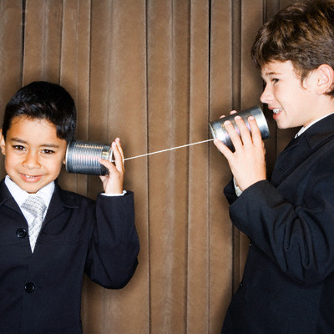
Digital Citizenship - Communication
- Electronic exchange of information
Notes:
Explain definition; talk about methods; go through remaining slides and talk about whether they are good or bad forms of digital communication. For the bad ones, talk about how they could be made better.

Slide 2
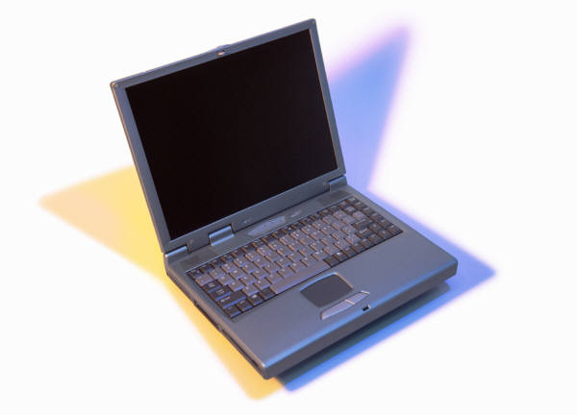
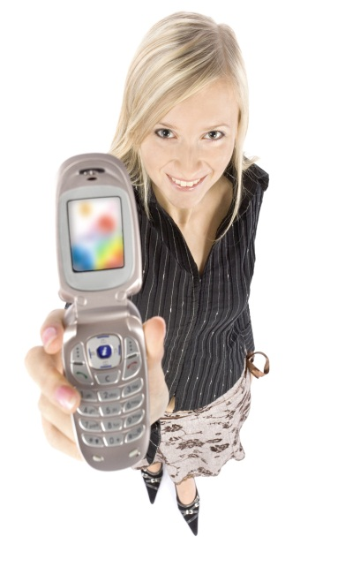
Digital Communication Methods
Computers:
Email
Skype
Instant Messaging
Twitter
Social Networks (Facebook, MySpace)
Blogs
DSi
Cell Phones:
Texting
Video chat
Picture Mail
Internet Access
What kind of information can be exchanged? And how much?
ENDLESS!

Slide 3
Good or Bad Communication?
http://listverse.files.wordpress.com/2010/01/halo_effect_good_and_bad_egg.jpg

Slide 4
http://www.tcd.ie/disability/projects/DS3/index.php
Going on vacation to the Bahamas with the whole family for one week! C Ya later!

Slide 5
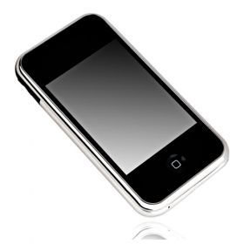
You’re always late!
You’re always late ☺

Slide 6
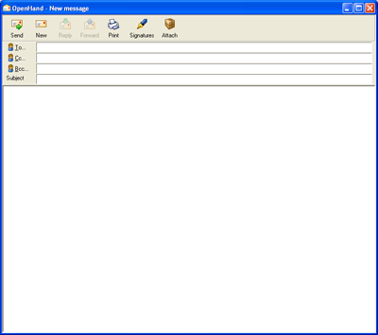
Mr. Smith@mywork.com
Hey Boss,
I’m not feeling good today. I won’t make it into work. Sorry!
Ms. Hamlin

