Slide 1
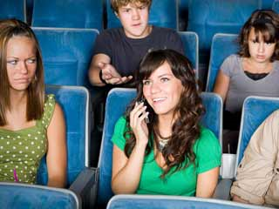
Digital Citizenship – Etiquette
Definition: Digital Etiquette is the basic set of rules you should follow in order to make the internet better for others and better for yourself.
A.K.A NETIQUETTE
Appropriate or Inappropriate?

Slide 2
Inappropriate vs. Appropriate
Turning cell phone ringers to vibrate or silent when in public areas
Texting while carrying on conversations
Using technology for bullying or like behaviors
Unwillingness to share public technology
Using camera phones inappropriately
Offering to share technology with others
Keeping cell phone conversations private by moving 10-20 feet away from others and speaking with a soft voice
Carrying on loud cell phone conversations in crowded areas or at public performances
Inform adults of misuse of technology (bullying)
Using communication devices for non-class related issues during class time

Slide 3
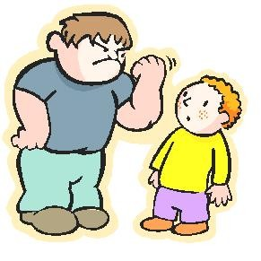
Which student are you?
How does that make you feel after watching that video?

