Slide 1
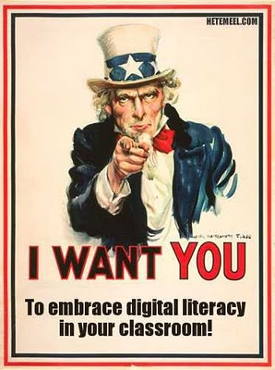
DIGITAL LITERACY
- Process of teaching and learning about technology and the use of technology.
What does that mean?
Properly using email, searching techniques, browsers and evaluating websites for accuracy and reliability.
http://the-crafty-librarian-portfolio.blogspot.com/

Slide 2
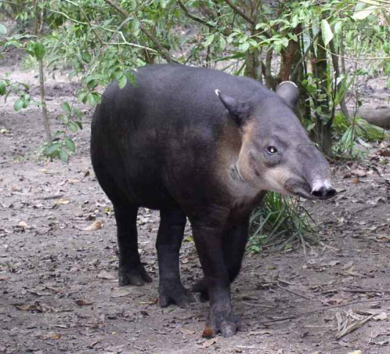
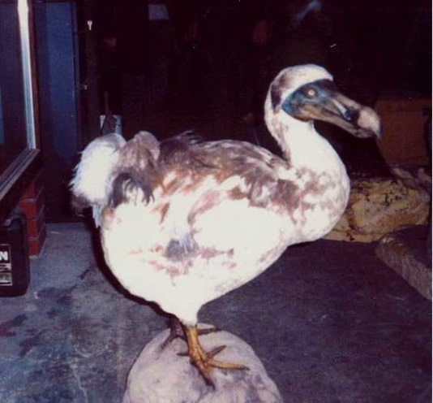
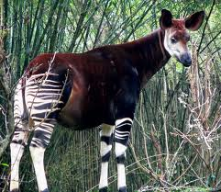
Internet Reliability
Tapir
Dodo Bird
Okapi
Which one isn’t endangered?
How do search engines work?
Spoof Site: When individuals or groups create sites that are intended to make fun of something or to create a hoax.

Slide 3
Sites for Evaluation
Look at these sites. What makes them “real” looking? How can they trick people into giving away information or learning false information?
The Jackalope Conspiracy
The Tree Octopus
Dihydrogen Monoxide
BSA

Slide 4
Guides to Evaluating Websites
Is the information what you expected? Does it seem true?
Who wrote it?
Is the information up-to-date?
Do other websites support the same info?
Where does it come from and what does it look like?
Who recommended this online source to you?
Is the information worth using? How important is it?

