Slide 1
http://www.bradtechonline.com/protect-your-computer-with-one-of-the-top-anti-virus-software-packages/
Digital Security
Electronic precautions to guarantee safety
Self Protection
Firewalls, passwords, backup devices and anti-virus software.
Appropriate: Responsibly using securing software, updating frequently. Communicate through secure networks.
Inappropriate: Not utilizing security software to protect your computer.

Slide 2
Phishing
Trying to steal sensitive/personal information such as usernames, passwords, and credit card details
http://www.smh.com.au/news/web/aussies-still-ignorant-about-phishing/2007/10/04/1191091252153.html

Slide 3
Private vs. Public
full (first and last) name
your favorite band
e-mail address
phone numbers
credit card numbers
Social Security number
mother’s maiden name
your age
your opinion about an important issue
passwords
calling card numbers
whether you are male or female
how many brothers and sisters you have
your favorite food
how many pets you have
the name of your pet
postal address
Notes:
Group discussion: Which is private and which is public information?

Slide 4
Scenario 1
Jason is 13 and enjoys playing a multiplayer online role playing game. The game involves players from all over the world. Sometimes while playing, he messages other players, usually swapping game strategies. He frequently runs into one particular player, whom he recognizes by his character and has played with for a year. The player offers to send Jason a book about gaming tips. Jason wonders if he should give his address.
Notes:
What should Jason do?

Slide 5
Scenario 2
Mary is 14 and has over 1000 friends on Facebook. She has never rejected a friendship request before. Another 14 year old named Charles becomes Mary’s friend and they begin to Facebook chat quite often. He is really funny and flirty but doesn’t have any tagged pictures or many friends. Mary starts to think she might have a crush on him. Charles offers to meet Mary at her home or after school so they can hang out. Mary wonders if this would be okay.
Notes:
What should Mary do?

Slide 6
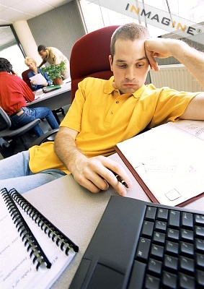
Digital Health & Wellness
Psychological and physical well being in a digital technology world.

Slide 7
Appropriate and Inappropriate
Spending way too much time on the Internet.
Student's feet can't touch the floor and student's screen is not at eye level.
Becoming addicted to internet
Using laptop computers on a surface that would hinder a person's posture
Using the internet without proper digital etiquette and engaging in cyber bullying activities
Limit the amount of time on the Internet and consideration to other responsibilities.
Student's feet should touch the floor and the computer screen at eye level.
Students should use computers on hard surfaces, have elbows level with keyboard, and bend neck slightly.
Students having limited or supervised usage to internet activities
Notes:
Determine what is appropriate and what is inappropriate.

