Slide 1
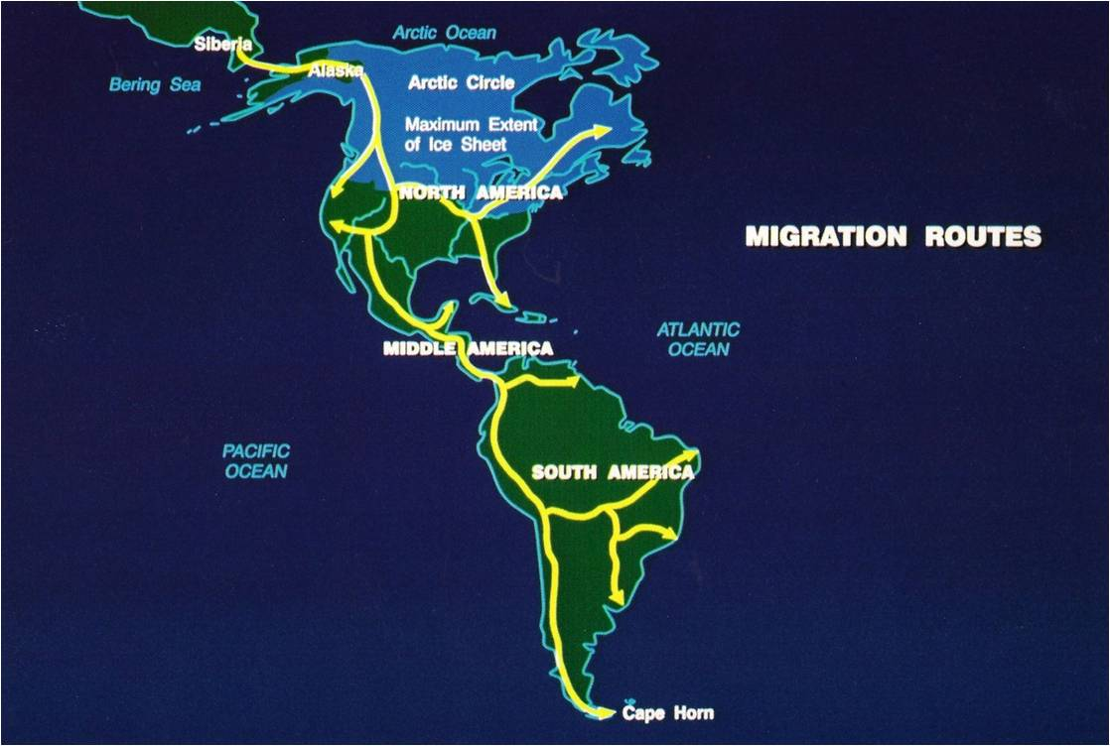

Slide 2
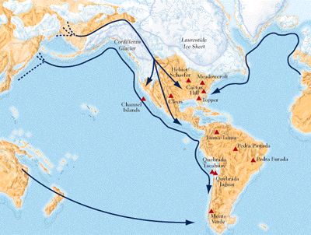

Slide 3
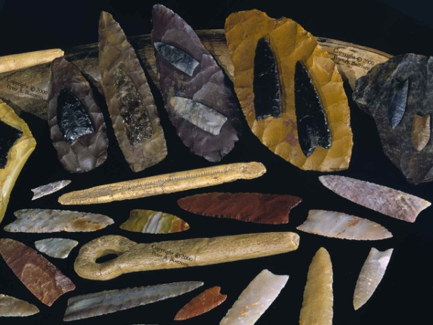
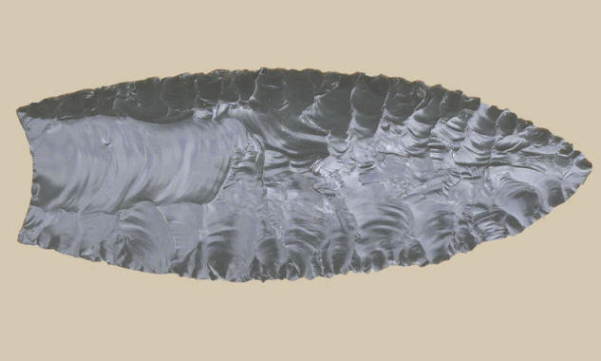
Into the Americas
1. Where does the article take place?
2. How old were the artifacts found?
3. What is the chopper tool used for?
4. What was the knife tool used for?
5. How old is Browns Valley Man?
6. How old is Minnesota Woman?
7. How old is the Bison Itasca Kill site and how many people hunted there?
8. At the end of the last ice age, so much water was locked in glaciers that global ocean levels dropped ____________ ______________ _______________.
9. Explain the 3 different pieces of evidence when people came to America?
10. Where are the Clovis spear points made?

